Slide 1
Accessing freely available public datasets from The Cancer Imaging Archive
Justin Kirby
Technical Project Manager
Email: justin.kirby@nih.gov

Slide 2
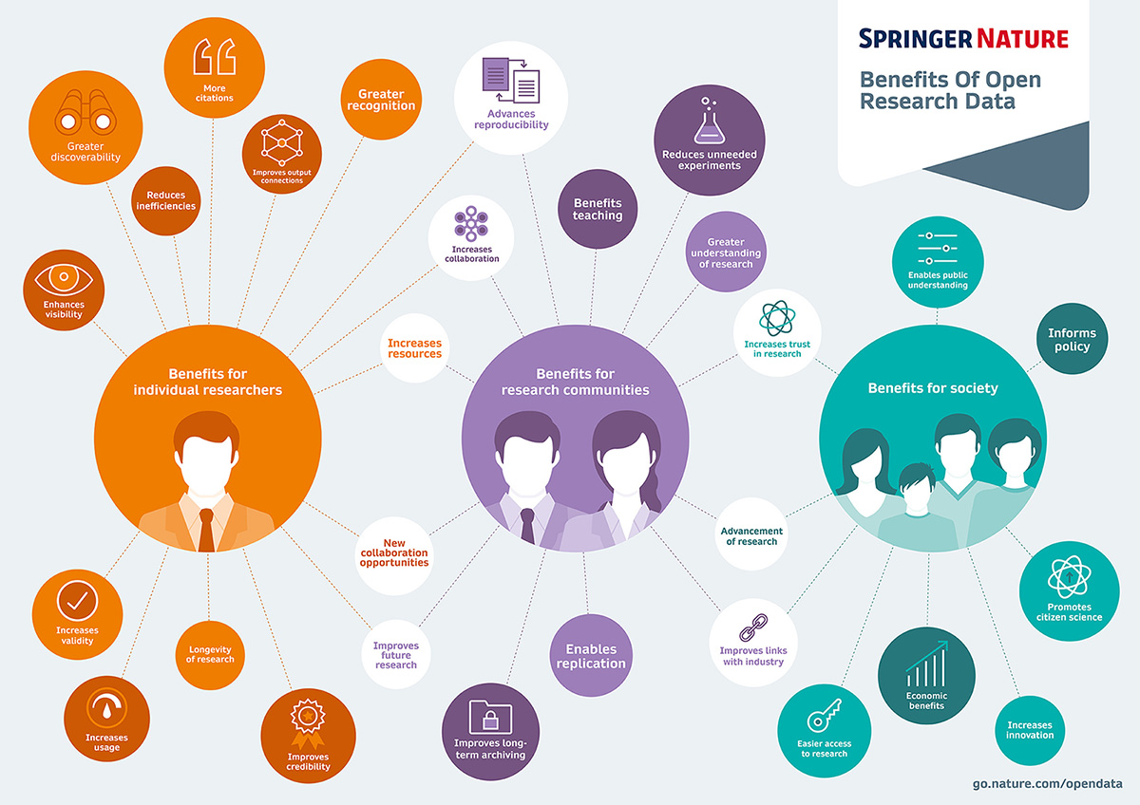
Data sharing enables better science
Increasing data sharing requirements as the value of sharing becomes more clear
Journal requirements
Funding requirements
Example: National Institutes of Health (NIH)
Data sharing plan required since 2003 for grants higher than $500K/year in direct support
Data sharing plan required for *all* funding mechanisms starting in January 2023
Numerous additional requirements from NIH programs which require depositing data in specific databases: https://www.nlm.nih.gov/NIHbmic/nih_data_sharing_policies.html

Slide 3
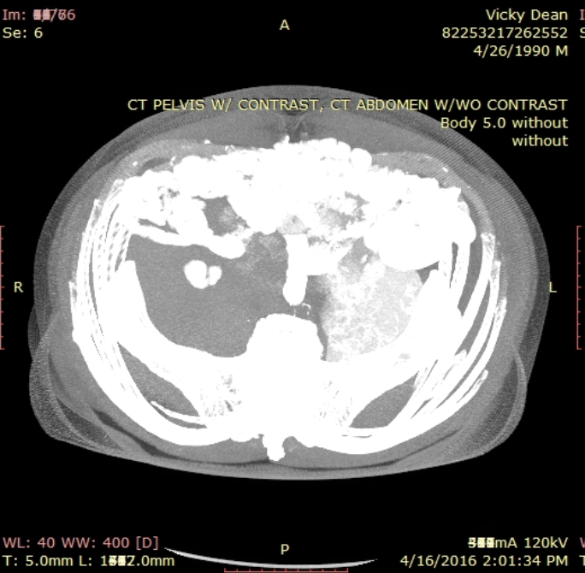
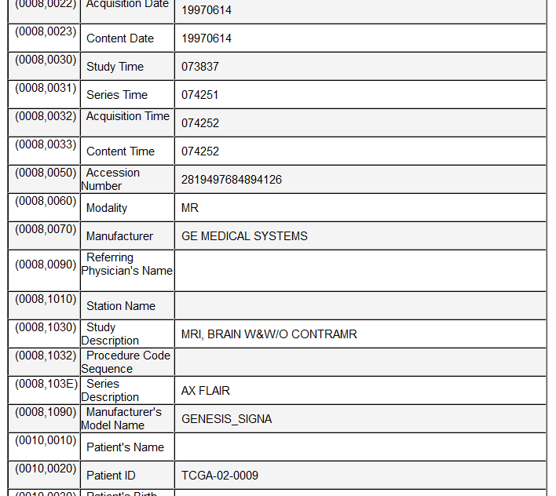
Sharing radiology (DICOM) data isn’t easy!
PHI can appear in hundreds of places in DICOM
Pixel data
Dates
Identifiers
Descriptions
“Private tags” with ambiguous proprietary content
Simplistic de-id approaches throw away important acquisition metadata that prevents reuse
Convert data to NIFTI, PNG, JPEG
Retain DICOM, but use overly aggressive cleaning methods

Slide 4
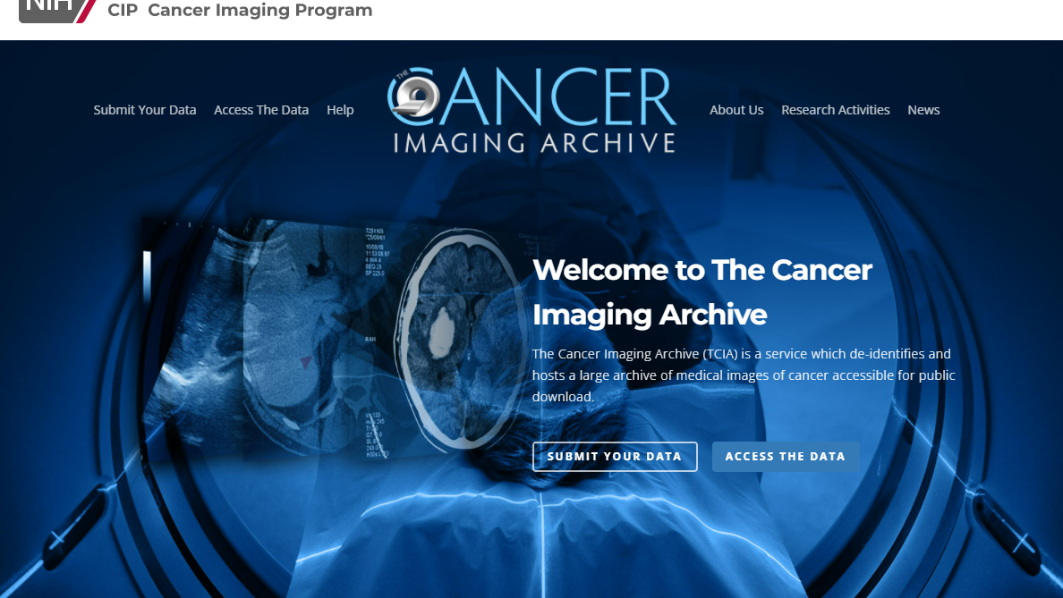
Notes:
“Today I’ll be reviewing The Cancer Imaging Archive…” (just intended to show our home page and say hello)

Slide 5






Funding, Governance, Implementation
Funding and Governance
Management and implementation
Subcontract implementation
Notes:
Funded and governed by NCI/CIP/DCTD, managed by FNLCR, and implemented in collaboration with several subcontractors.

Slide 6
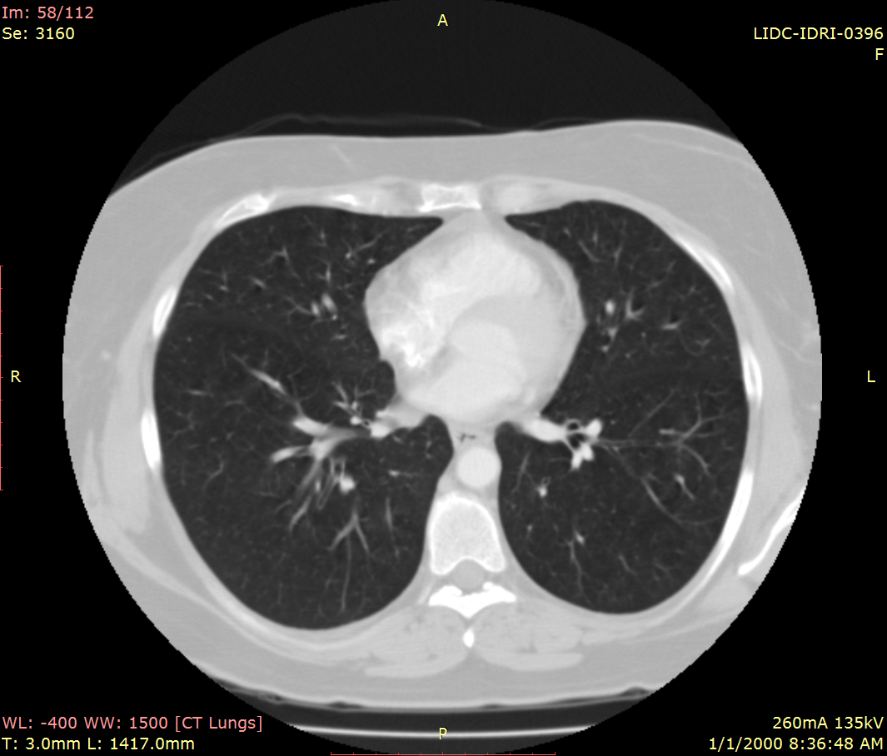
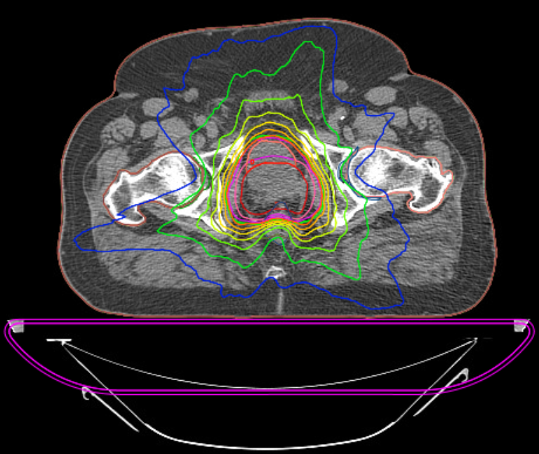
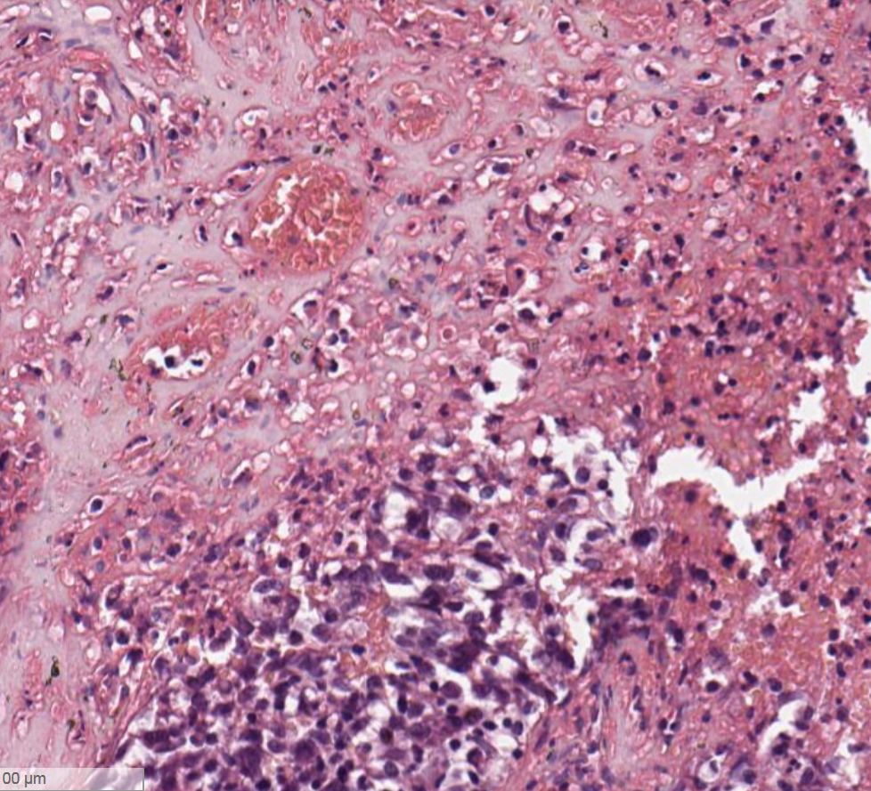
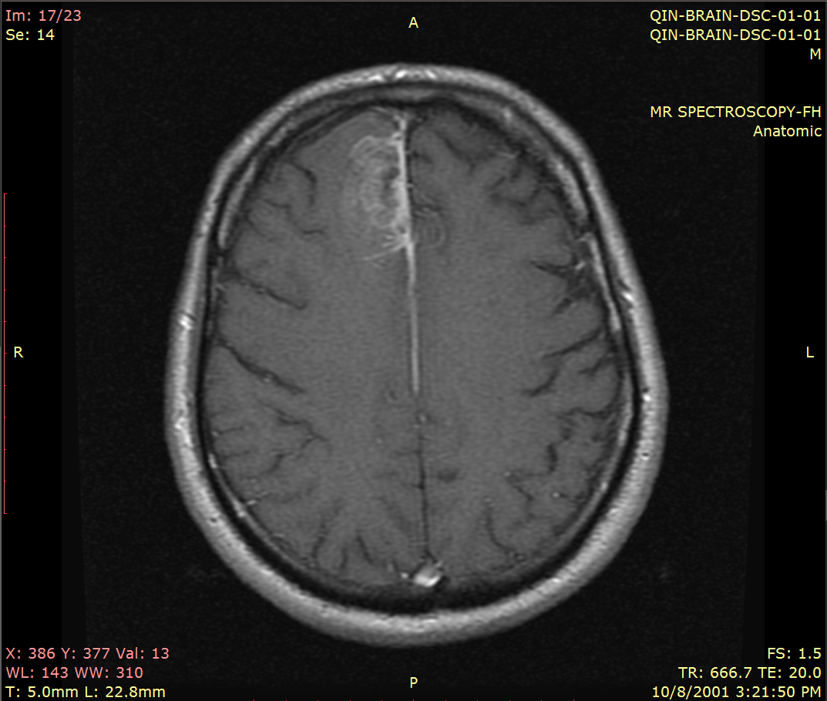
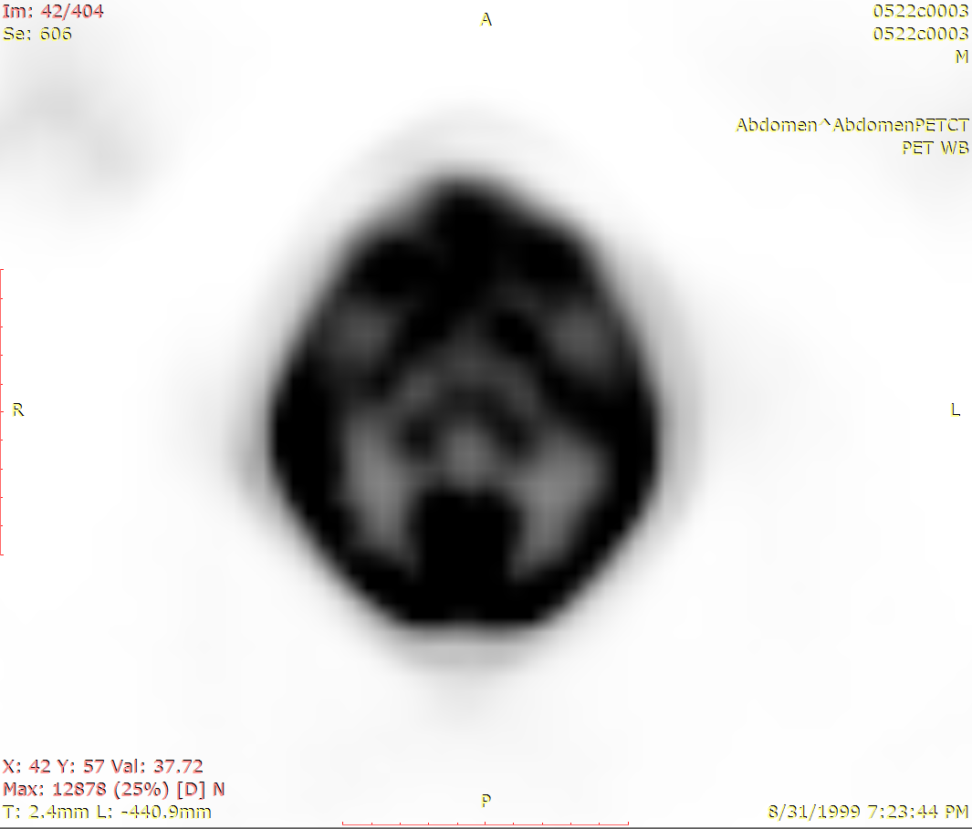
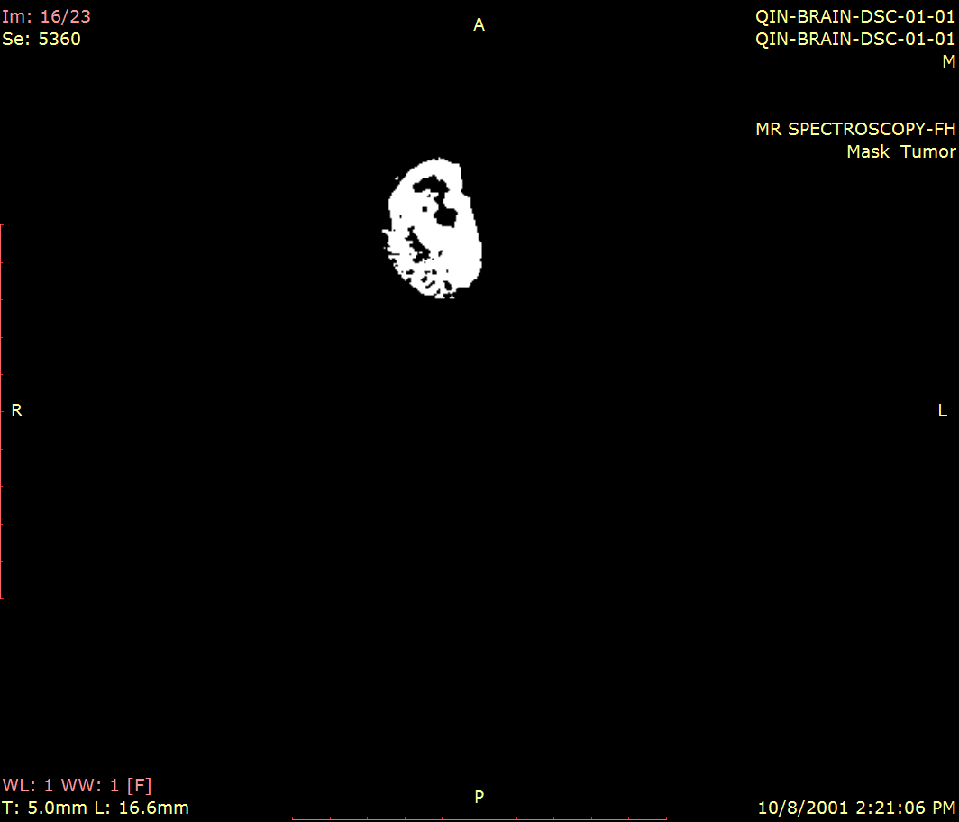
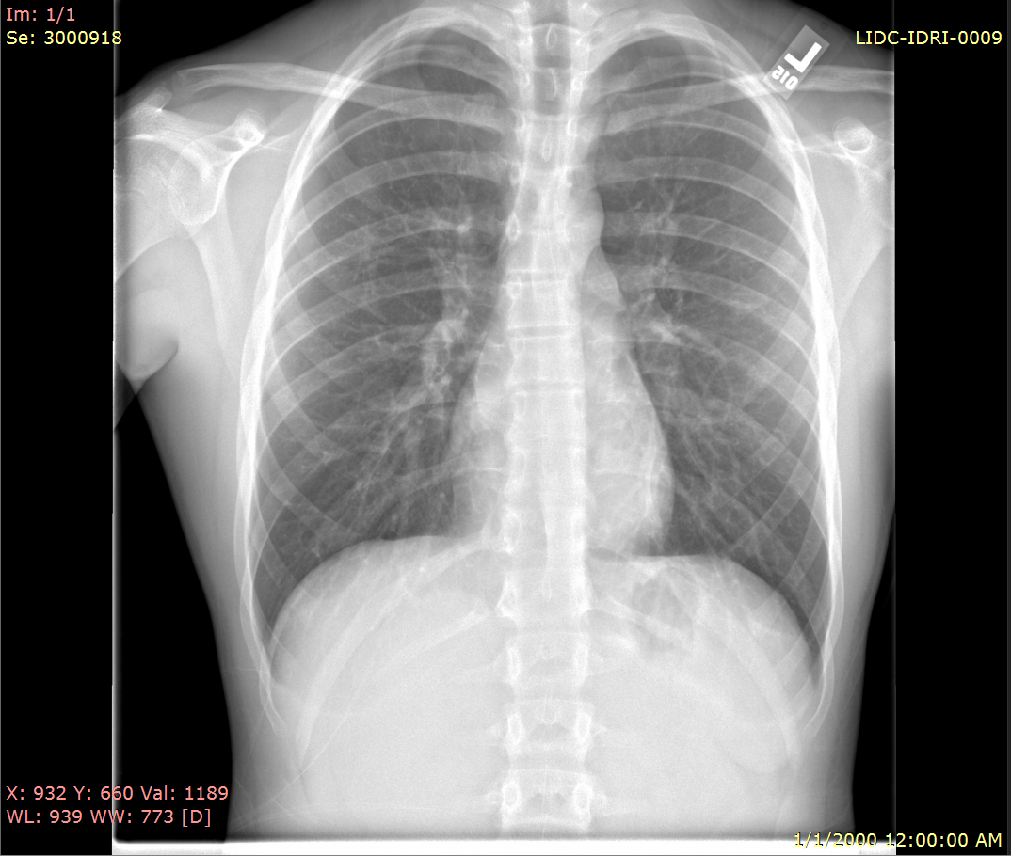
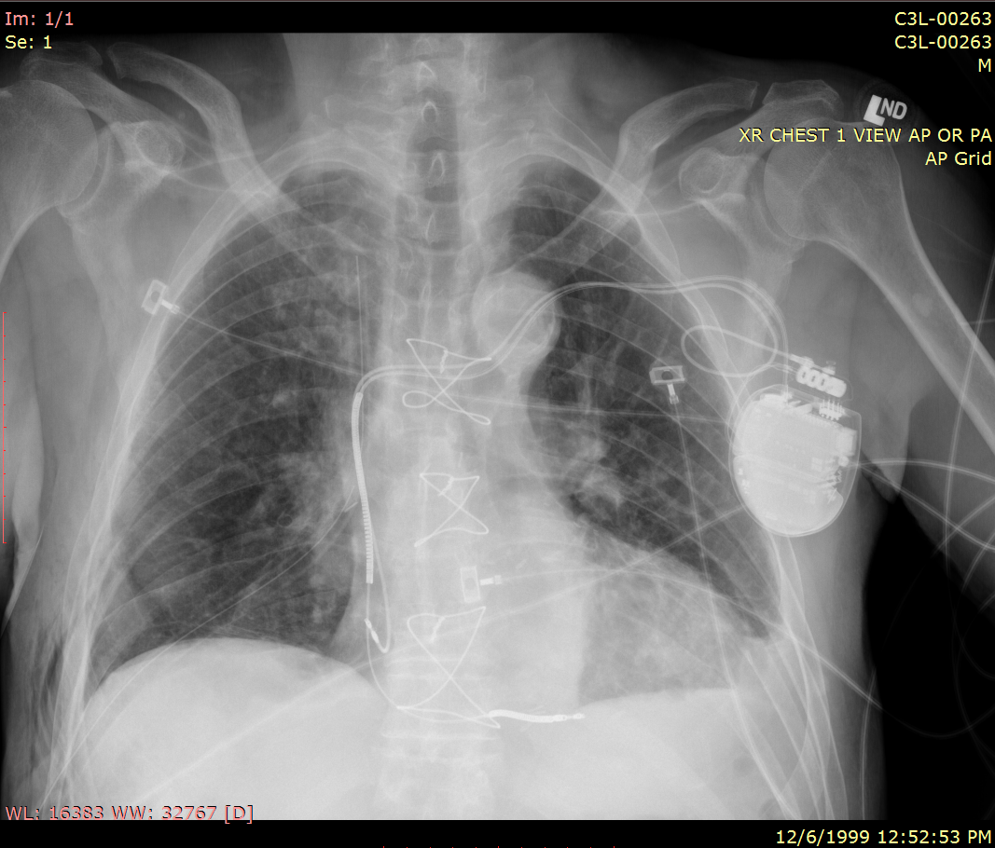
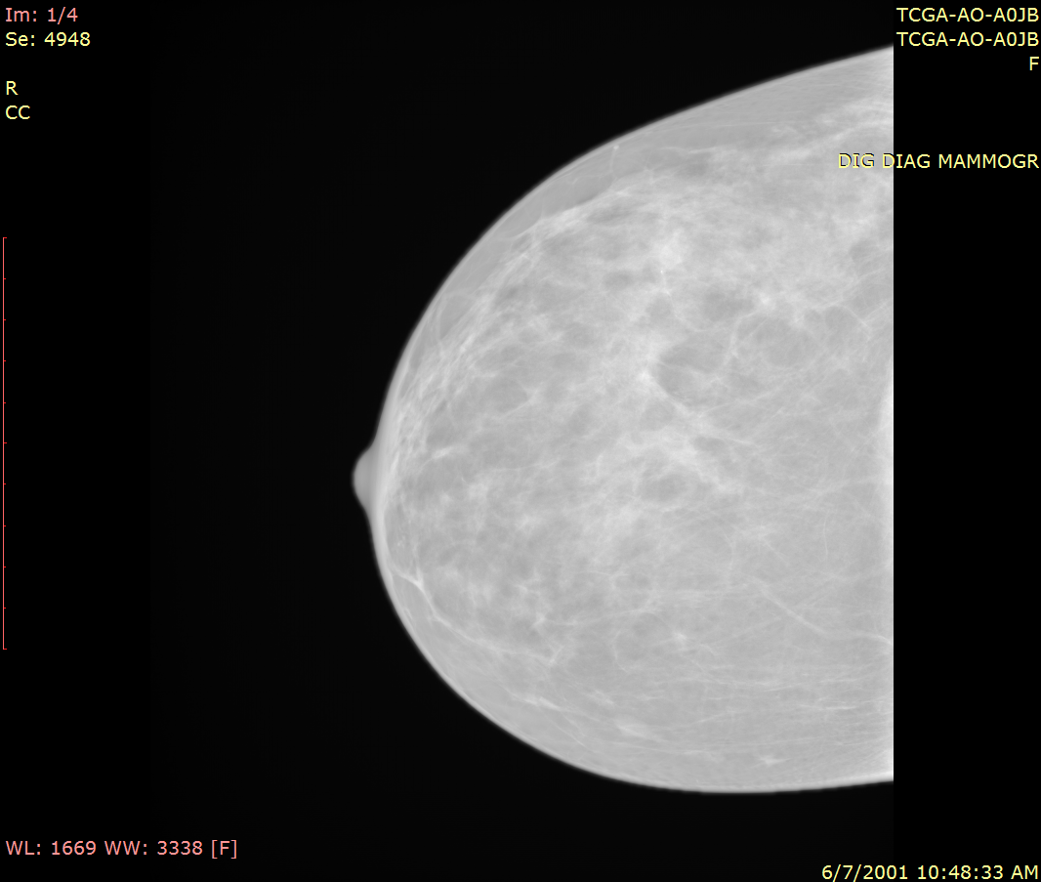
What kind of data are currently available in TCIA?
CT
RTSTRUCT
RTDOSE
WSI
180 Collections
140 radiology and radiation therapy datasets
68,408 subjects
71,295,973 images
28.3 TB of storage
40 histopathology datasets
5,126 subjects
219,254 images
8.45 TB of storage
8 mice collections (6 PDX models)
Canine GBM dataset from ICDC
32 Analysis Result datasets based on TCIA collections
Wide variety of cancers, modalities + phantoms
Most have associated supporting data
Clinical (e.g. demographics/outcomes/therapy)
Image analyses (e.g. segmentations)
Genomics/Proteomics
COVID-19 initiative
MRI
PET
SEG
DX
CR
MG
Notes:
Wide variety of data including human, mice, canine subjects across radiology, RT and histopathology image modalities. Over 160 collections consisting of more than 50 million images. 29 community contributed analysis result datasets which annotated existing TCIA collections to further their utility for AI/ML and other purposes. Most datasets include supporting data to make the images more interesting for re-use such as clinical and ‘omics data. We also have a handful of COVID datasets which were collected as part of an emergency response to the pandemic and to help kickstart the NIBIB MIDRC initiative.

Slide 7
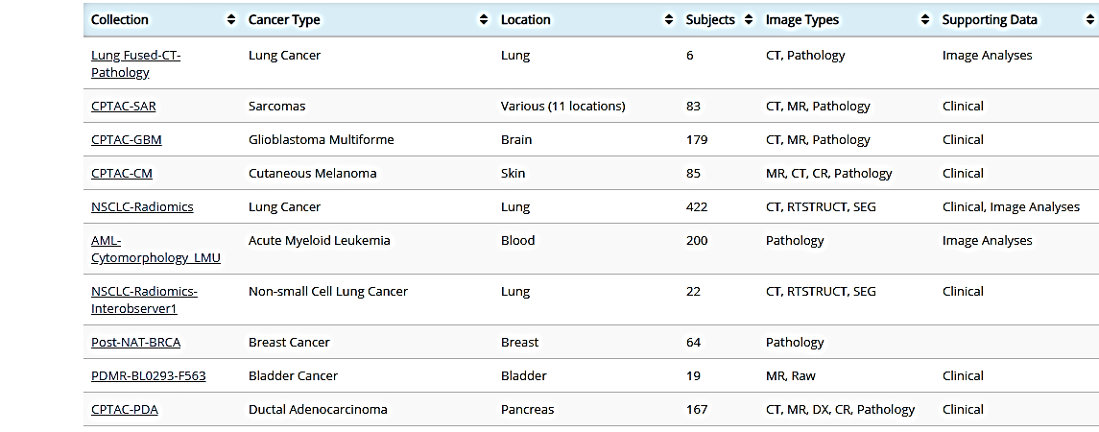
Data sets for AI on TCIA using the Browse Collection page
“Labels”: Classifications Segmentations
Notes:
23=RESTRUCT or SEG
48=Image Analyses
59=Clinical (or OMIC)
non-NLST TCIA collections include: 20,263 subjects, 36,203 studies,
+25M images.
+70 TB downloaded every month

Slide 8
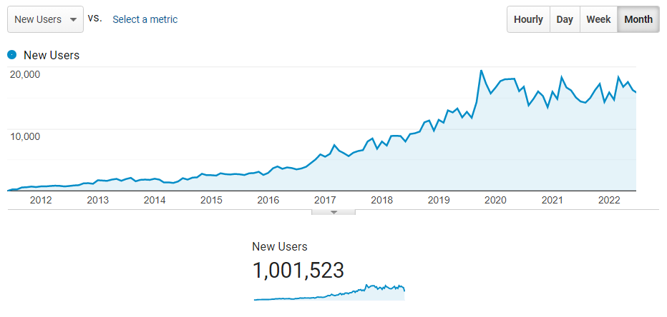
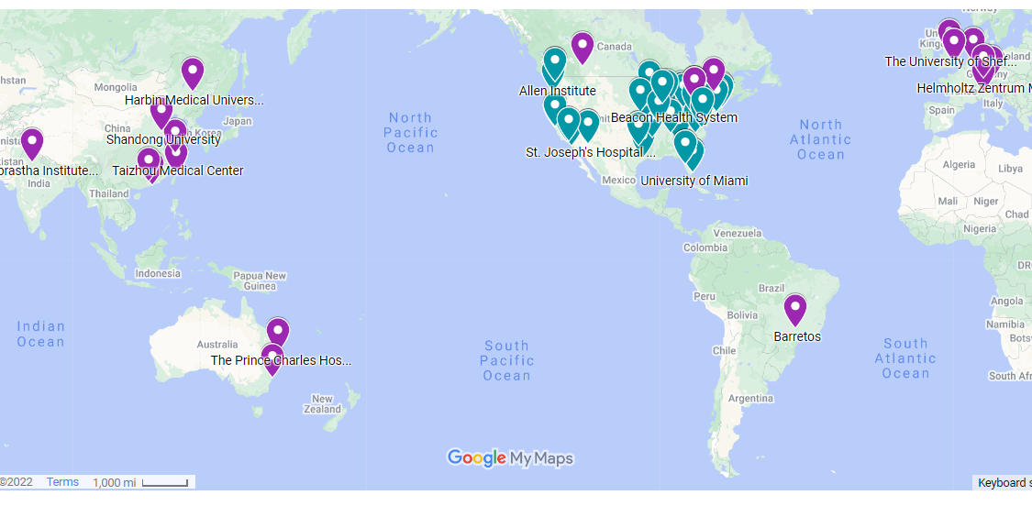
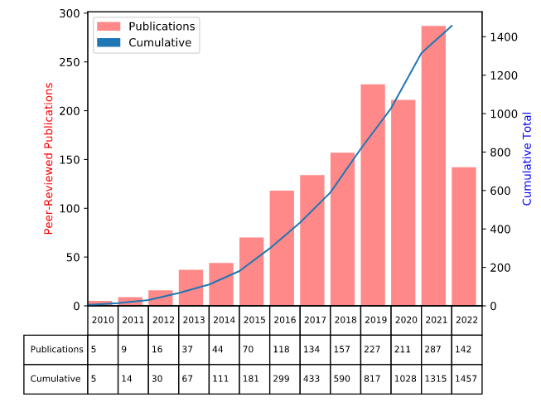
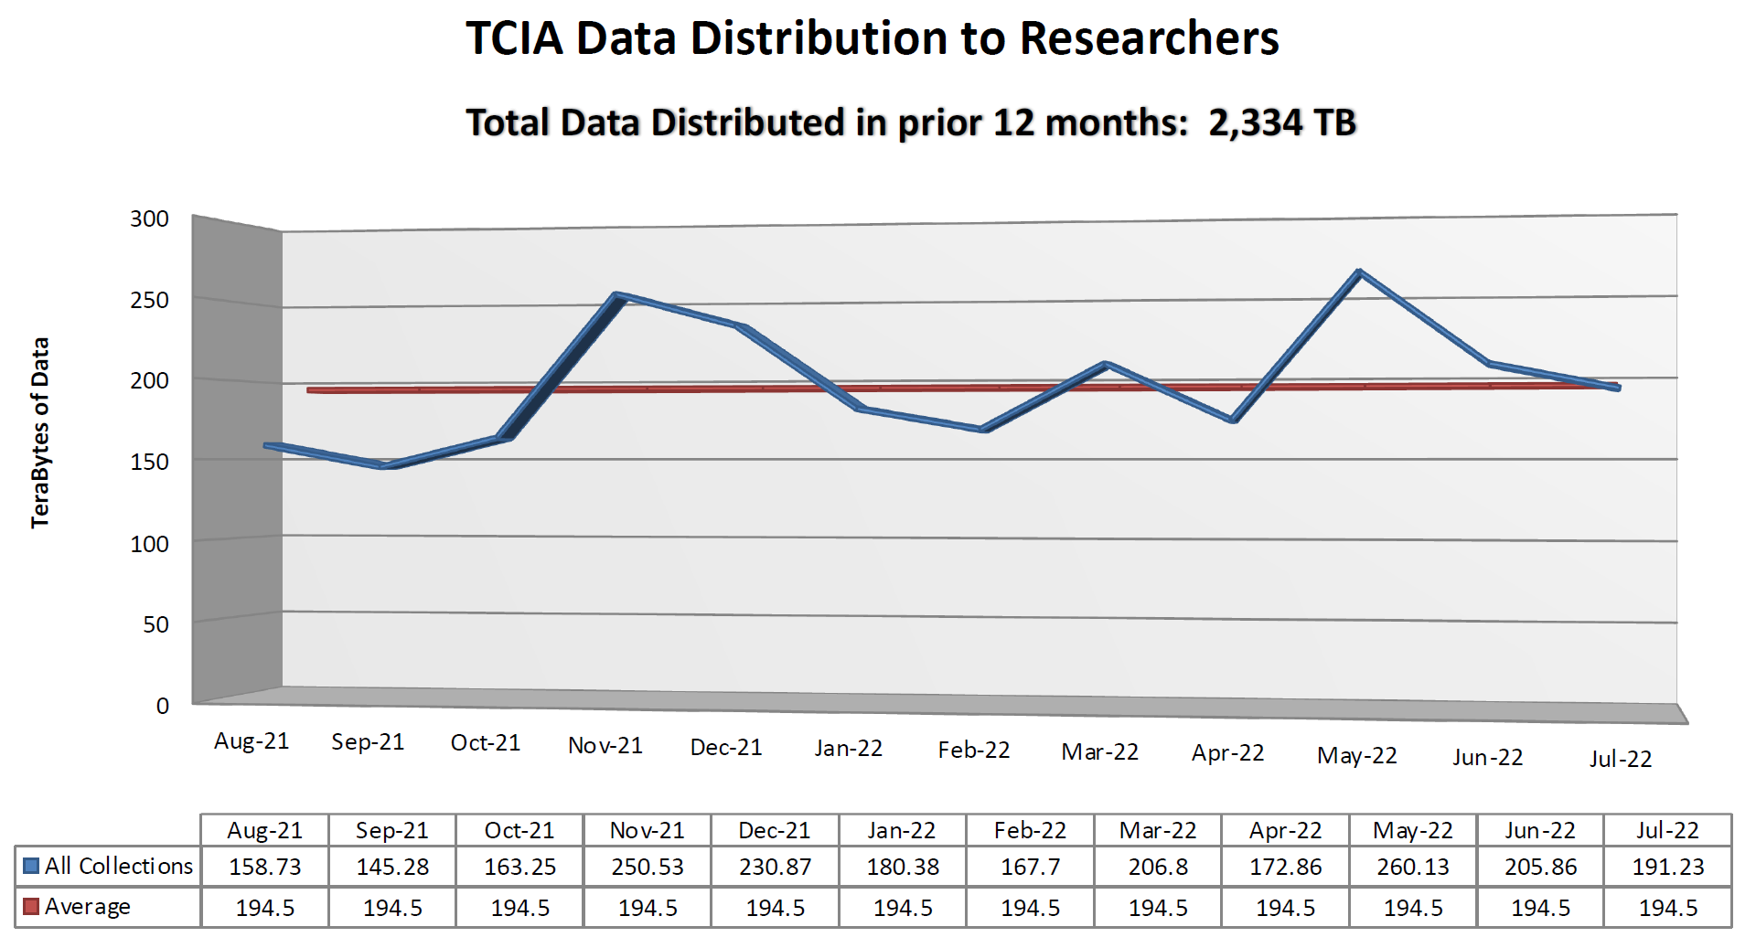
TCIA is heavily utilized by the research community
New users per month
Data has been collected from over 85 institutions worldwide
As of August 2022 TCIA has served over 1,000,000 users from 224 countries and regions
On average 20K users access TCIA each month
Users downloaded 2.3PB in FY22, an average of 192TB per month
TCIA is a recommended repository for Nature, PLOS One, Medical Physics, Elsevier and many more scientific publishers
Over 1,450 peer-reviewed publications based on TCIA datasets
85+ Contributing Institutions

